Slide 1
Inhalation Anesthesia
ชัยพฤกษ์ กุสุมาพรรณโญ
ภาควิชาวิสัญญีวิทยา คณะแพทยศาสตร์
มหาวิทยาลัยศรีนครินทรวิโรฒ

Slide 2
Content
Physical property of gas
Potency of inhaled anesthetics
Uptake and distribution
Emergence or recovery
Anesthetics highlights

Slide 3
Inhaled Anesthetics
anesthetics that are administered by inhalation
2 groups
anesthetic gas : nitrous oxide (N₂O)
: xenon (Xe)
volatile anesthetics : 4 agents

Slide 4
Physical Property of Gas
Partial pressure
Solubility
Solubility coefficient
Partition coefficient

Slide 5
Physical Property of Gas
Partial pressure
“at a given temperature, the amount of gas which dissolves in a liquid is directly proportional to the partial pressure of the gas in equilibrium with the liquid”
Henry’s Law

Slide 6
Physical Property of Gas
Solubility
partial pressure
temperature
gas/liquid

Slide 7
Physical Property of Gas
Solubility coefficient
Partition coefficient

Slide 8
Solubility coefficient λ
Volume of gas which dissolves in unit volume of liquid at a given temperature at 1 atm. equilibrium (Bunsen)
Regardless of the gas volume

Slide 9
Partition coefficient δ
The ratio of the amount of substance in one phase compared with a second phase
Each phase must be equal in volume at equilibrium
Can be applied to two liquids but the Ostwald coefficient applies to partition between gas and liquid

Slide 10
Solubility coefficient λ
Partition coefficient δ
N₂O
N₂O 1.4 L
1 L N₂O gas
1 L blood
1 L oil (fat)
1 L blood
↑
1 L H₂O
↑
1 L blood
N₂O 0.39 L N₂O 0.47 L
N₂O 0.47 L N₂O 0.47 L

Slide 11
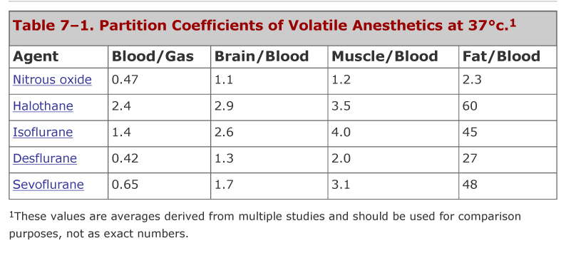
Partition coefficient λ

Slide 12
Diffusion
Fick’s Law
The rate of diffusion of a substance across unit area is proportional to the concentration gradient.
Graham’s Law
The rate of diffusion of a gas is inversely proportional to the square root of its molecular weight.

Slide 13
Measurement of plasma and tissue concentration
Normally, we measure plasma conc. for IV, IM, oral drugs > μg/ml
For inhalation, concentration in alveoli can be measured in ‘fraction’ (F_{i} F_{A})

Slide 14
Measurement of plasma and tissue concentration
For inhalation, concentration in blood/tissue can be measured in pressure unit (mmHg, kPa)
Concentration depends on partial pressure, temperature and solubility

Slide 15
Measurement of potency
MAC = minimum alveolar concentration that inhibits somatic movement of 50% animals subject to painful stimuli
MAC-BAR (blockade of adrenergic responses)
MAC-Awake
ED₉₅ or AD₉₅

Slide 16
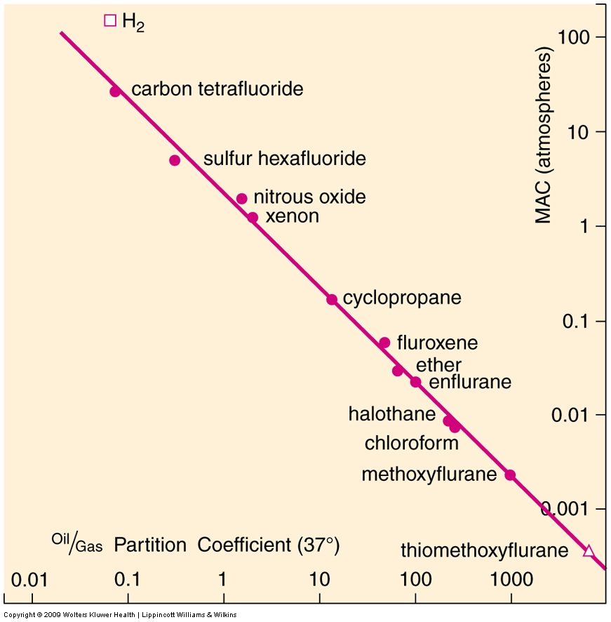
λ_{o/g} and MAC
Very weak
Meyer-Overton hypothesis: relationship between MAC and lipid or oil/blood solubility
Poorly soluble

Slide 17
Physical properties
4 things to remember
Partial pressure
Solubility
Diffusion
Potency

Slide 18
Factors affecting MAC
Decrease | Increase | No effect
Hypothermia (animals) Severe hypotension (animals) Age (humans) Opioids, ketamine (humans, animals) Chronic administration of amphetamine (animals) Reserpine, α-methyldopa (animals) Cholinesterase inhibitors (animals) Intravenous local anesthetics (humans, animals) Pregnancy (animals) Hypoxemia (Pao₂ <40 mm Hg) (animals) Anemia (animals) α₂-Agonists (animals, humans) | Hyperthermia (animals) Hypernatremia Hyperthyroidism (animals) ??? Alcoholism (humans) Acute administration of dextro-amphetamine (animals) Genetic | Duration of anesthesia (humans, animals) Sex (human, animals) Metabolic acid-base status (animals) Hypercapnia and hypocapnia (humans, animals) Isovolemic anemia (animals) Hypertension (animals) Mg level Hyperkalemia

Slide 19
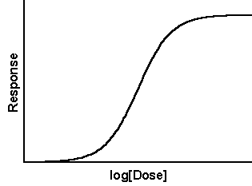
Dose –response curve
100
95

Slide 20
Dose –response curve
Individual variability exists
Dose adjustment to clinical responses
Stimuli or causal agent (strong/weak)
e.g. microorganism virulence, pain

Slide 21
1.0
MAC-BAR
MAC-awake
MAC-incision
MAC-intubation
0.5
Probability of unresponsiveness
0
Anesthetic concentration

Slide 22
Physiochemical Properties of Volatile Anesthetics
Property | SEVORANE | DESFLURANE | ISOFLURANE | ENFLURANE | HALOTHANE | N₂O
Boiling point (°C) | 59 | 24 | 49 | 57 | 50 | -88
Vapor pressure at 20°C (mm Hg) | 157 | 669 | 238 | 172 | 243 | 38,770
Molecular weight (g) | 200 | 168 | 184 | 184 | 197 | 44
Oil:gas partition coefficient | 47 | 19 | 91 | 97 | 224 | 1.4
Blood:gas partition coefficient | 0.65 | 0.42 | 1.46 | 1.9 | 2.50 | 0.46
Brain:blood solubility | 1.7 | 1.3 | 1.6 | 1.4 | 1.9 | 1.1
Fat:blood solubility | 47.5 | 27.2 | 44.9 | 36 | 51.1 | 2.3
Muscle:blood solubility | 3.1 | 2.0 | 2.9 | 1.7 | 3.4 | 1.2
MAC in O₂ 30–60 yr, 37°C P_{B}760 (%) | 1.8 | 6.6 | 1.17 | 1.63 | 0.75 | 104
MAC in 60–70% N₂O (%) | 0.66 | 2.38 | 0.56 | 0.57 | 0.29
MAC, >65 yr (%) | 1.45 | 5.17 | 1.0 | 1.55 | 0.64 | —
Preservative | No | No | No | No | Thymol | No
Stable in moist CO₂ absorber | No | Yes | Yes | Yes | No | Yes
Flammability (%)(in 70/30 N₂O/O₂) | 10 | 17 | 7 | 5.8 | 4.8
Recovered as metabolites (%) | 2–5 | 0.02 | 0.2 | 2.4 | 20
MAC, minimum alveolar concentration; N₂O, nitrous oxide.

Slide 23
Uptake & Distribution
Uptake from external source
Distribute throughout the whole body (compartments) via bloodstream
Aim target : brain
4 steps of uptake & distribution

Slide 24
Basic concepts of uptake
F_{i} (fraction of inspired anesthetics)
F_{A} (fraction of alveolar anesthetics)
Uptake from alveoli results in dropping of F_{A}
FA/ Fi below 1.0

Slide 25
Basic concepts of uptake
Equilibrium is reached when F_{A}/ F_{i} is 1.0 or no more uptake to blood occurs
End point is partial pressure or tension of anesthetics in brain, NOT the amount of anesthetics up-taken
As long as partial pressure is reached it is assured that uptake has happened appropriately

Slide 26
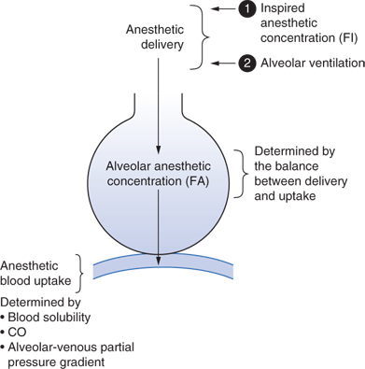
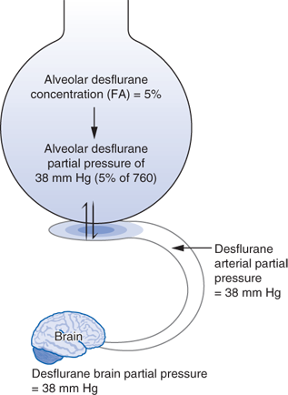
Fi 5%
F_{A} 5%
P_{Partial} 5%

Slide 27
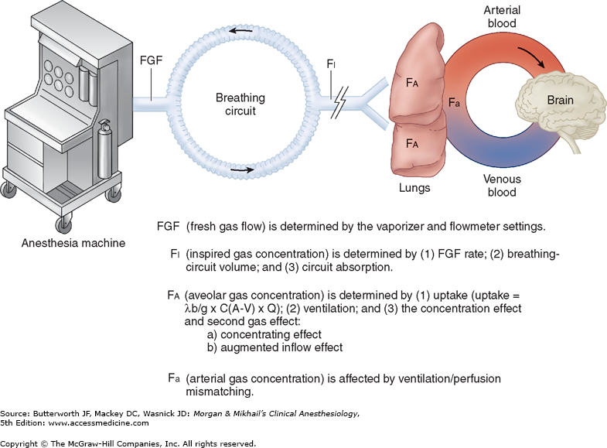

Slide 28
Uptake & Distribution (cont.)
F_{I}
I. Uptake to alveoli
alveolar ventilation
inspired concentration (concentration effect)
second gas effect
F₃
N₂O
O₂
N₂O
F₃
N₂O
O₂
N₂O
F₃
F₃
O₂
N₂O
O₂
F_{A}
F₃
O₂
O₂

Slide 29
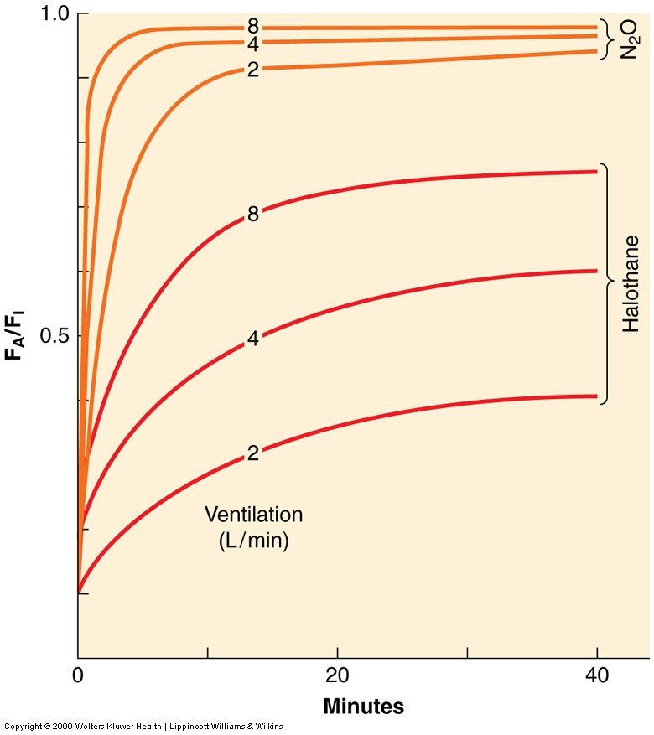
Alveolar ventilation effect on uptake
MV =
minute ventilation
(L/min)

Slide 30
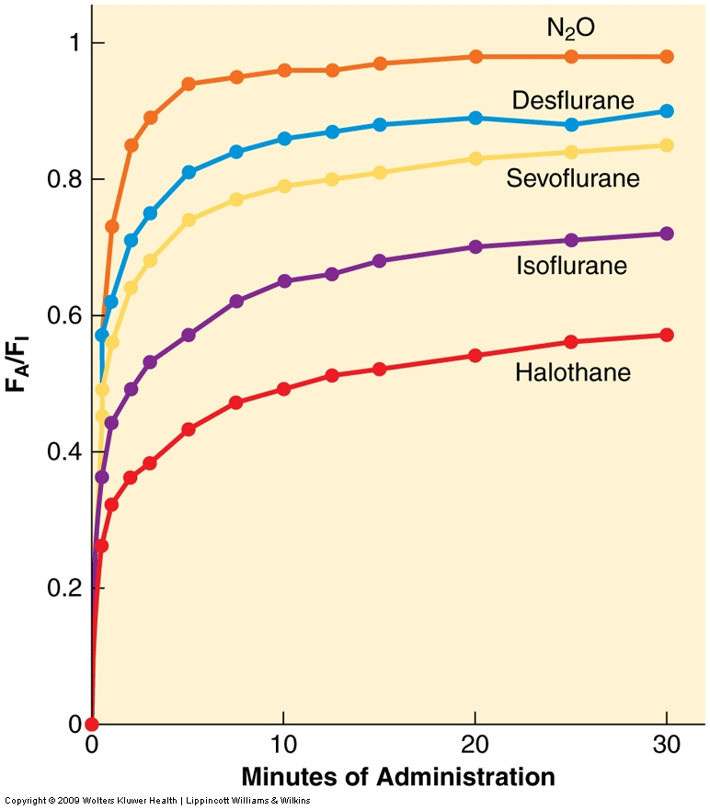
Comparison of alveolar uptake of inhaled anesthetics

Slide 31
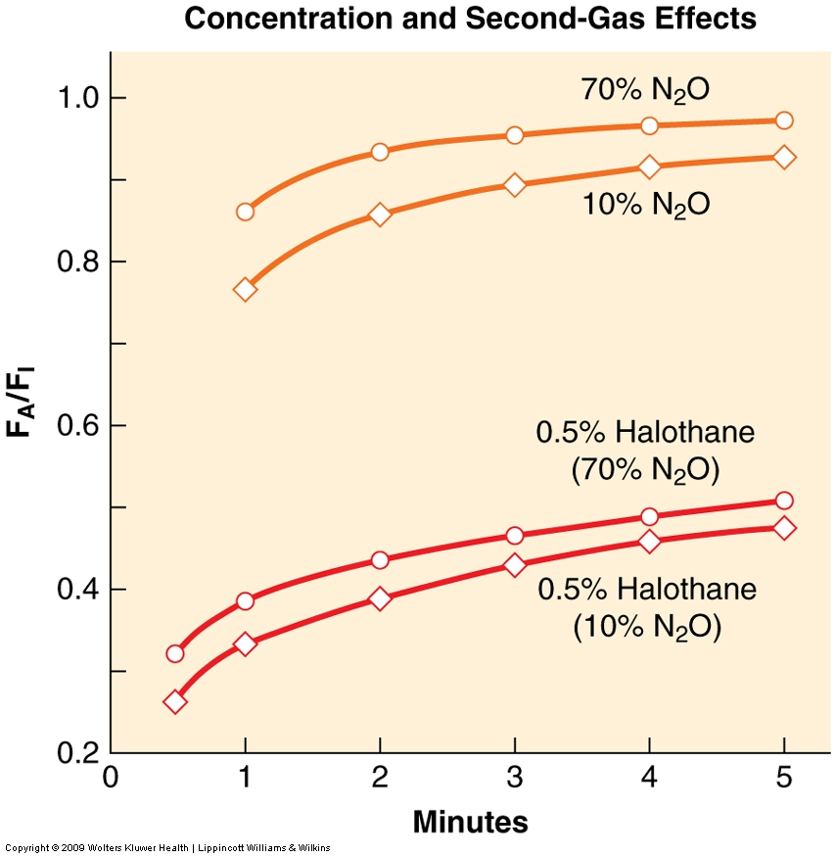
Concentration effect and
Second gas effect
Concentration effect
Second gas effect

Slide 32
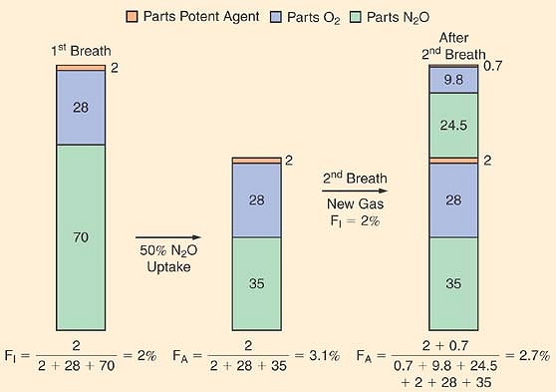

Slide 33
Uptake & Distribution (cont.)
II. uptake into bloodstream
blood/gas solubility λ_{b/g}
cardiac output
alveolar/blood pressure gradient
O₂
F₃
N₂O
F₃
O₂
N₂O
N₂O
N₂O
F₃
O₂
O₂
F₃
O₂
O₂
F₃
N₂O
N₂O
O₂
O₂
F₃
F₃
N₂O
N₂O
O₂
F₃
O₂
O₂
F₃
N₂O
N₂O
F₃

Slide 34
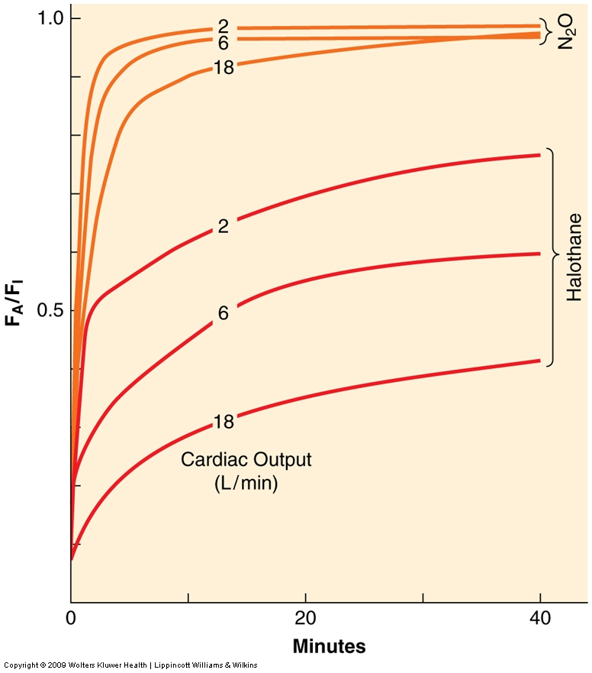
Effect of cardiac output on uptake

Slide 35
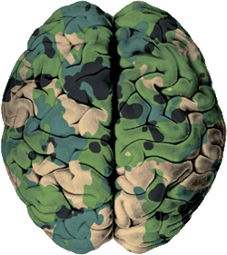
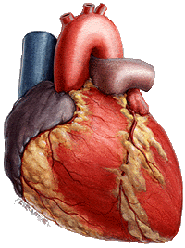
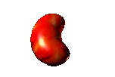
Uptake & Distribution (cont.)
F₃
N₂O
O₂
III. tissue uptake
tissue solubility λ_{o/b}
tissue blood flow
tissue/blood pressure gradient
N₂O
N₂O
O₂
O₂
F₃
N₂O
O₂
F₃
N₂O
O₂
N₂O
F₃
F₃
N₂O
N₂O
O₂
F₃
F₃
F₃
O₂
N₂O
N₂O
F₃
O₂
F₃
O₂
F₃
F₃
F₃
N₂O
F₃
F₃
F₃
F₃
F₃
O₂
N₂O
N₂O

Slide 36
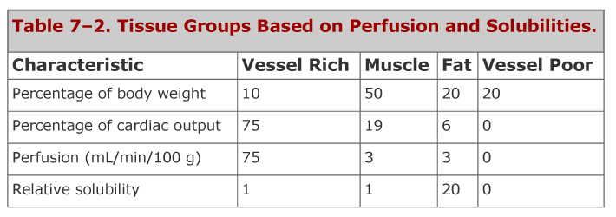
Tissue blood flow

Slide 37
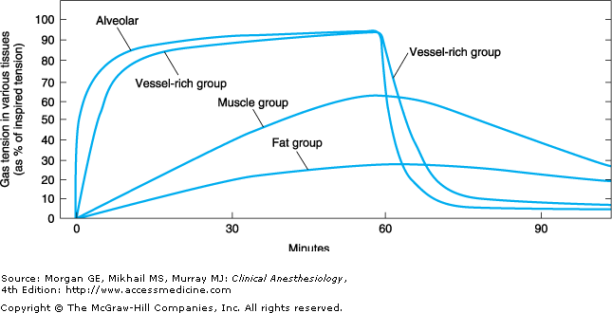

Slide 38
Uptake & Distribution (cont.)
N₂O
N₂O
IV. tissue equilibration
alveolar pressure equals tissue tension
different duration e.g. 5-15 min for brain, 2-4 hrs for muscle, up to 24 hrs for fat
O₂
F₃
F₃
N₂O
F₃
O₂
O₂
O₂
N₂O
F₃
F₃
O₂
O₂
F₃
N₂O
O₂
N₂O
F₃
O₂
F₃
O₂
N₂O
O₂
O₂
O₂
F₃
N₂O
F₃
F₃
F₃
O₂
N₂O
N₂O
F₃
N₂O
N₂O
O₂
N₂O
F₃
F₃
F₃

Slide 39
Recovery from anesthesia
solubility
duration
ventilation
N₂O
F₃
N₂O
O₂
F₃
F_{A}/F_{I} = ?
F₃
N₂O
O₂
O₂
F₃
O₂
F₃
N₂O
F₃
F_{A}/F_{A0} = ?
N₂O
F₃
F₃
O₂
N₂O
F₃
O₂
O₂
F₃
O₂
F₃
O₂
F₃
N₂O
N₂O
F₃
N₂O
F₃
N₂O
F₃
N₂O

Slide 40
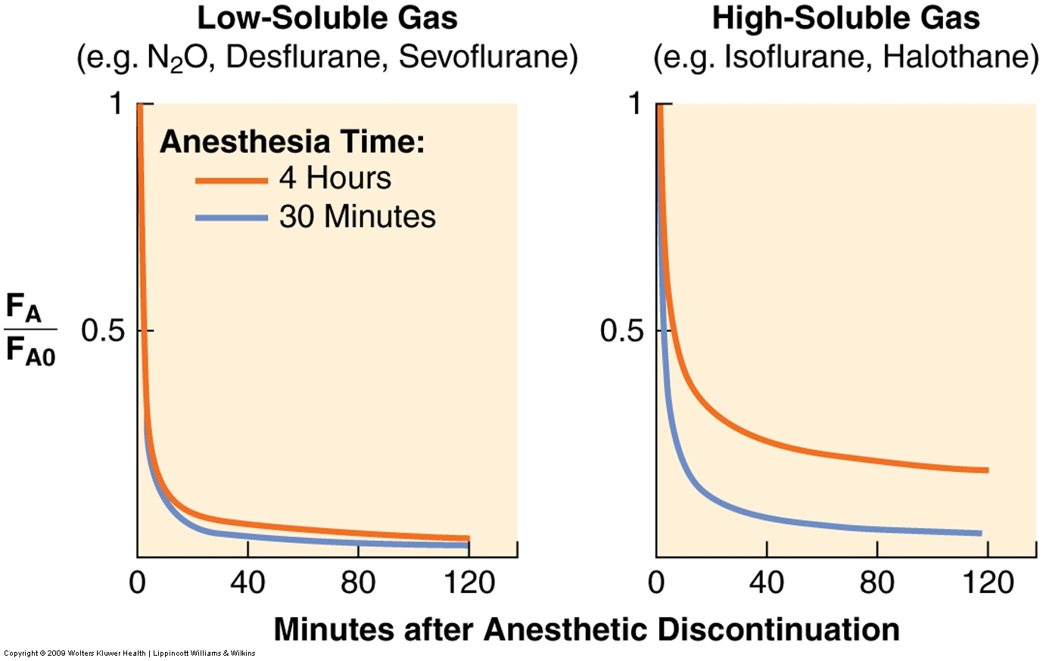

Slide 41
Common P’codynamics
CVS
Vasodilate
HR variable
Decrease CO
Myocardial depression
Arrhythmogenic
Respiratory
Bronchodilate
Decrease TV, MV
RR not affected
Decrease ventilatory drive to hypoxia
Inhibit hypoxic pulmonary vasoconstriction

Slide 42
Common P’codynamics
CNS
Increased cerebral blood flow
Trigger spike wave EEG
CMRO2 decrease except N2O
Toxicity
Malignant hyperthermia
Hepatitis
CO poisoning
Nephrotoxic
B12 depletion
Teratogenic

Slide 43
Anesthetics highlights
nitrous oxide (N₂O)
xenon (Xe)
halothane (F₃)
isoflurane
sevoflurane
desflurane

Slide 44
Nitrous Oxide (N₂O)
blue tank, 750 psi
second gas effect
very high MAC, 104%
expand closed gas space
diffusion hypoxia

Slide 45
Xenon (Xe)
Inert gas; extremely expensive
Approaching “ideal” anesthetics
Trigger MH
MAC 71% with λ_{b/g} 0.14
No myocardial depression

Slide 46
Halothane (F₃) Fluothane®
MAC 0.75
sensitize myocardium to catecholamines
arrhythmia especially coexisting hypoxia or hypercarbia
liver metabolism 20%
“halothane hepatitis” especially in reductive metabolism
Avoid re-exposure within 3-6 months

Slide 47
Isoflurane (Forane®)
MAC 1.2
suitable for neuroanesthesia
liver metabolism 0.2%
coronary steal syndrome
precaution in LV impairment

Slide 48
Sevoflurane (Sevorane®)
MAC 2.0
reaction with soda lime ⇒ compound A
compound A is prabably nephrotoxic in animal model
very low flow should be avoided
liver metabolism 3%
Cardioprotection (anesthetic
preconditioning, APC)
CO formed in dry soda lime

Slide 49
Desflurane (Suprane®)
low boiling point, high vapor pressure
MAC 6.0
Low oil/blood, low blood/gas
special electronic-powered vaporizer
liver metabolism 0.02%
more CO formed in dry soda lime

Slide 50
Organ injury from inhaled anesthetics
Liver injury
Trifluoroacylated hepatic protein adducts
Propensity parallel to liver metabolism
Halothane >>>> enflurane >>> isoflurane >> desflurane

Slide 51
Organ injury from inhaled anesthetics
Kidney injury
Sevoflurane >>> Hexafluoroisopropanol, formaldehyde, inorganic fluoride, CO₂ >> compound A
Desiccated carbon dioxide absorber
150 ppm-hour threshold
Normal BUN, creatinine but glucosuria and enzymuria

Slide 52
Organ injury from inhaled anesthetics
CO poisoning
CO formed with interaction between inhalation and desiccated carbon dioxide absorber
Desflurane >>> enflurane > isoflurane
NaOH, KOH-free is safe

